Slide 1
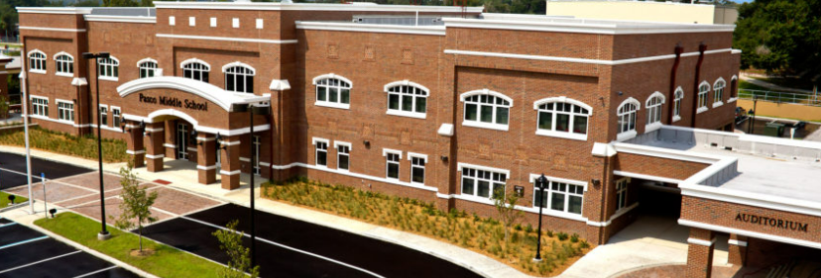
6th Grade Parent University
Pasco Middle 2022-2023

Slide 2
Goals For This Session
1. Get to know our school administration
2. Learn about our campus policies and procedures
3. Learn how to access materials to support your student
4. Who do I contact for assistance throughout the school year?

Slide 3
Following This Session
There will be a general Q & A with Administration
Dr. Julieann Usry jusry@pasco.k12.fl.us

Slide 4
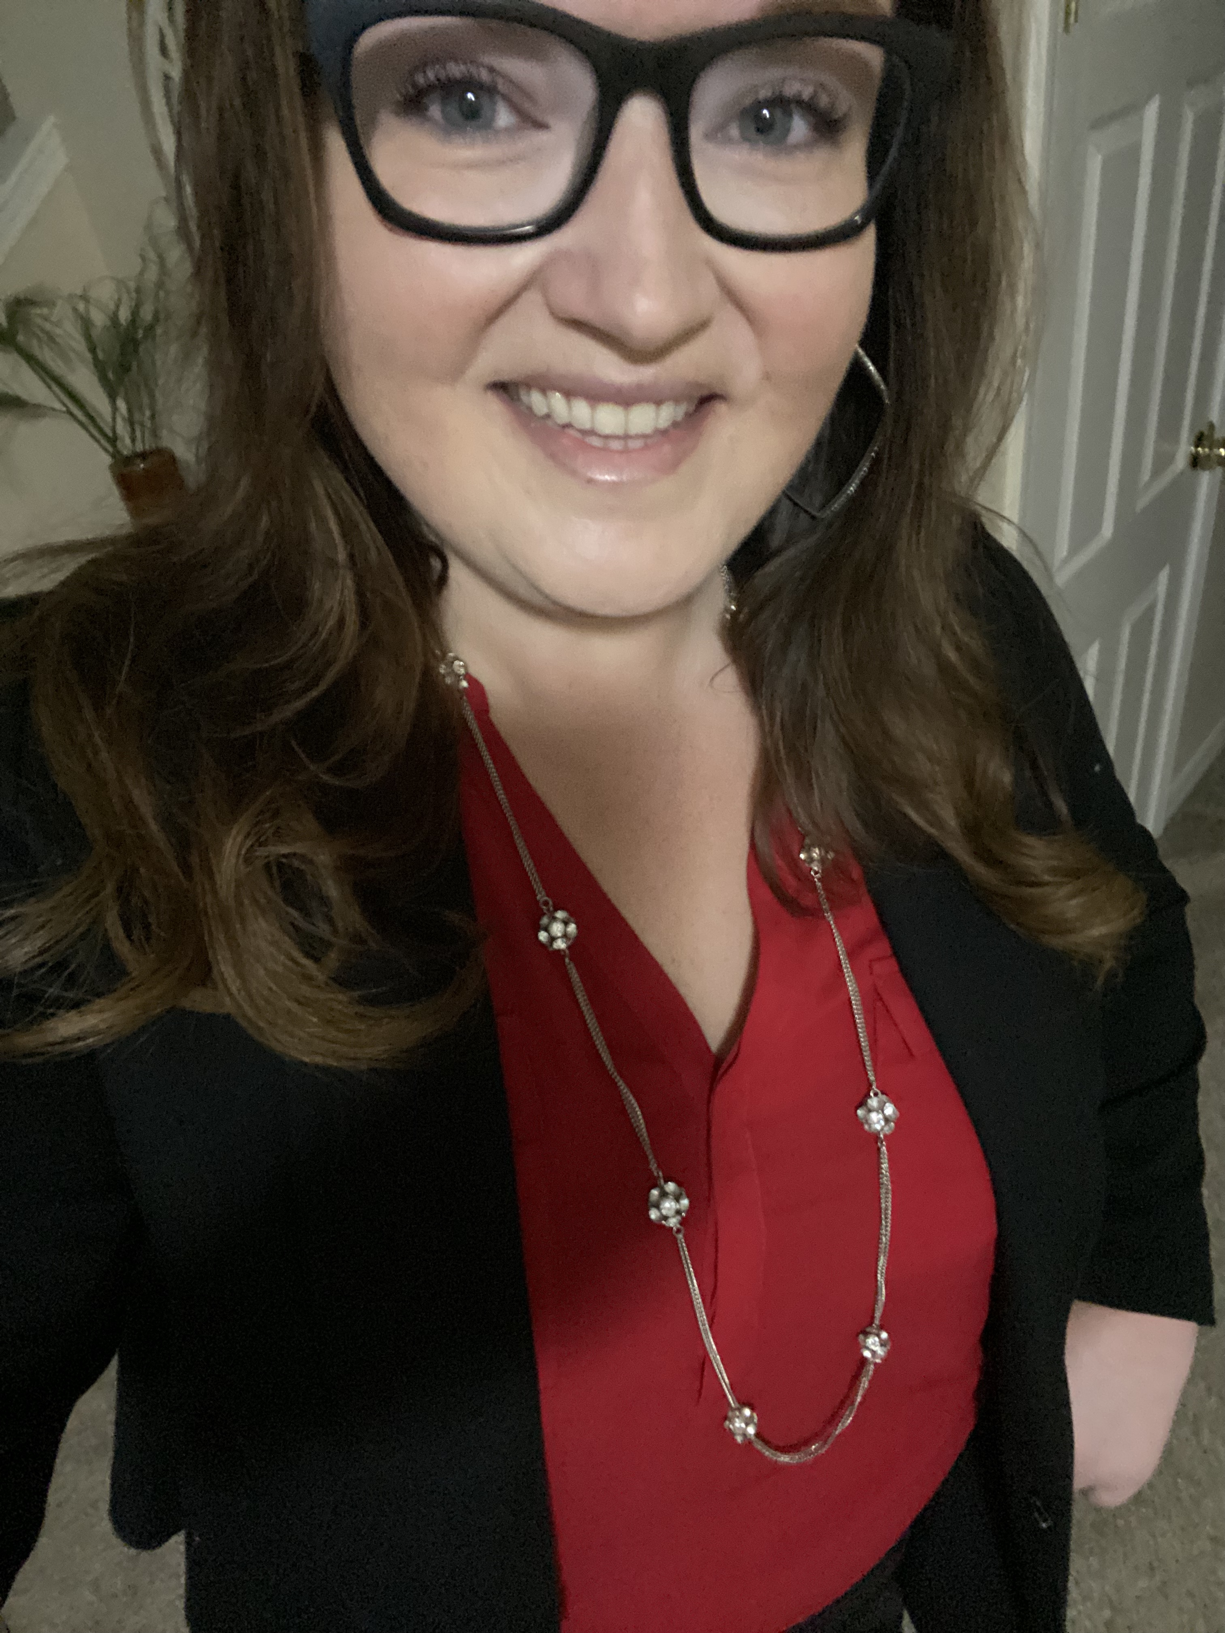
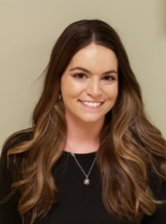
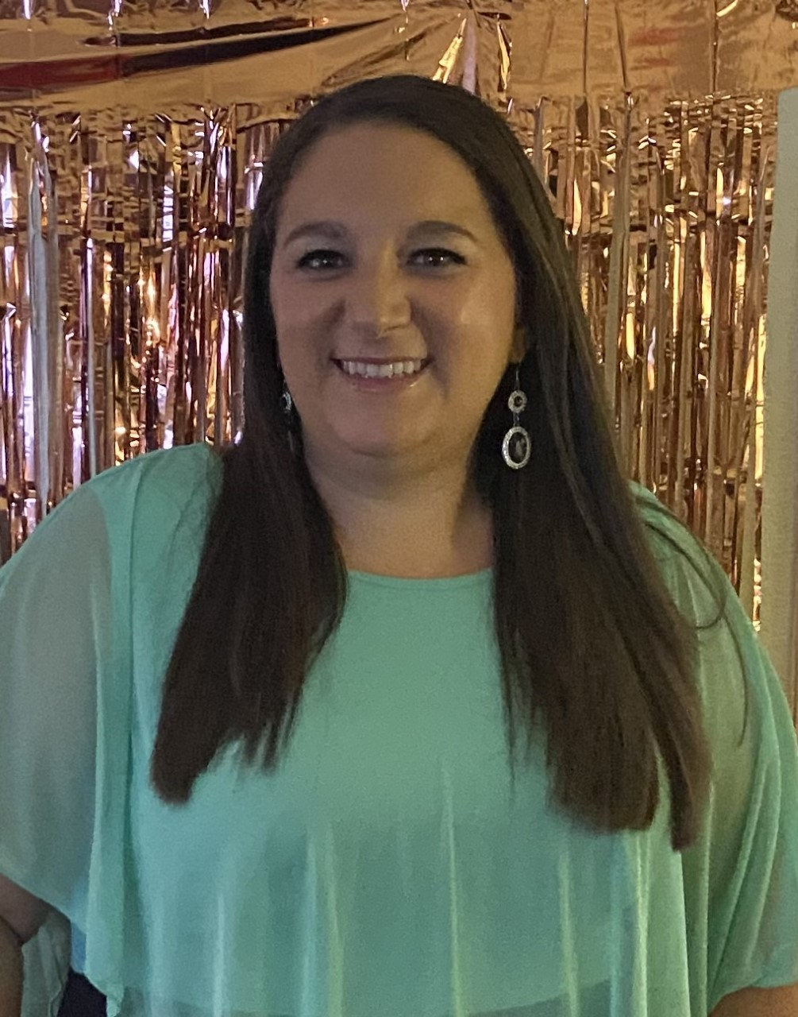
Peggy Gilbert
School Principal
Dr. Julieann Usry
Assistant Principal
Lisa Beth Shoemaker
Assistant Principal
Meet Our Pirate Administrators

Slide 5
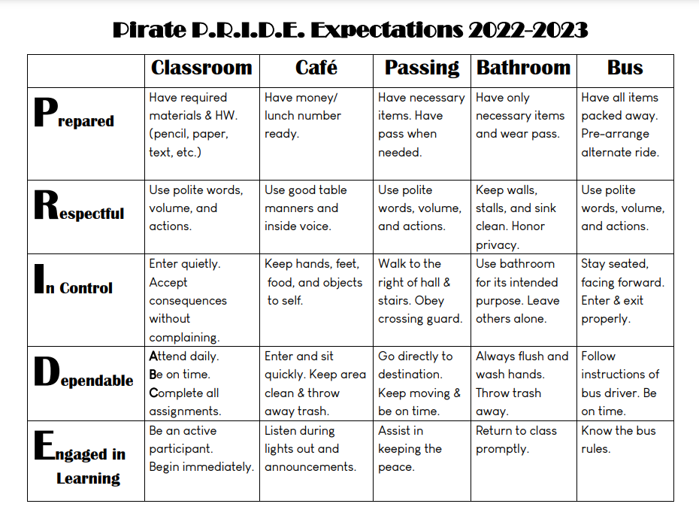
How Do Our Newest Pirates Show Their Pride?
8 Tips to Support Your New Middle Schooler

Slide 6
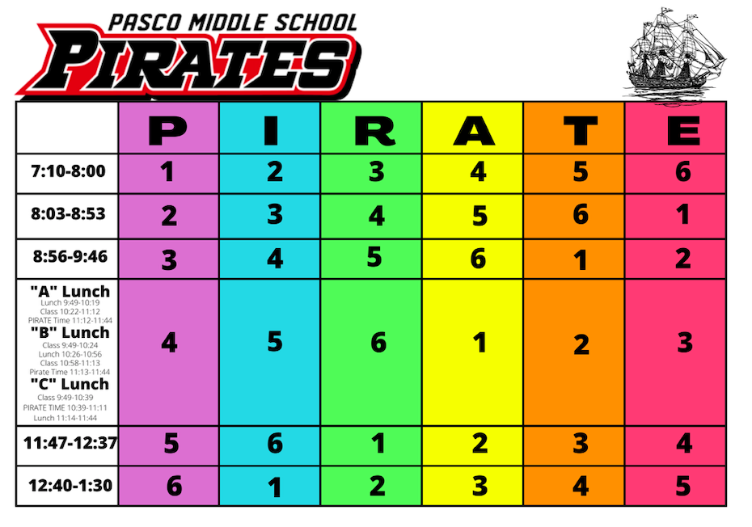
We Have a Rotating Bell Schedule

Slide 7
Clothing that is offensive may not be worn.
All shorts and skirts must be no shorter than 6 inches above the knee.
Pants will be worn securely. Students are allowed one inch of midrift on their shirts.
Shirts and tops must “cup” over the shoulder for both boys and girls.
Hats are now permitted on campus
Students in violation of the dress code will be required to change into appropriate clothing before returning to class.
Pasco Middle Dress Code
The complete dress code can be found on our school website.

Slide 8
Wireless Communication Device
The use of a WCD to engage in non-education-related communications during instructional time is expressly prohibited.
Students may use WCDs provided such uses do not create a distraction, disruption, or otherwise interfere with the educational environment at the following times:
Before and after school
During lunch
In-between classes
During after-school activities (extra-curricular activities)
At school-related functions
While on the school bus

Slide 9
6th Grade Schedules
Schedules will be available before school starts but are not finalized until the end of summer break (this is the ensure that all students FSA scores have arrived, and they are placed in the correct courses)
All 6th graders are required to take Health/PE so you will see it as an elective on their schedule
If your 6th grader has Intensive Reading they scored a Level 1 on the most recent FSA
6th graders were able to choose one (year-long) or two (semester) electives course other than Health/PE
Middle school is an opportunity for students to explore the many different course offerings to help them make informed decisions about their future in high school. We encourage students to take a variety of courses.
The school master schedule is created based off the student’s requests. Unless a 6th grader has a course on their schedule that they have already taken they will not receive a schedule change.

Slide 10
Drop-off and Pick-up Procedures Carline
Student Pick-Up
Afternoon pick-up will have one line running with a second lane for passing only.
Parent must contact the text the Google Voice 352-469-0093 to tell the school they have arrived.
Student names are called from the caller and then they will come to your vehicle
Students are not permitted to cross the parking lot for safety reasons.
Student Drop- Off
Students can be dropped off in the car loop at 6:45am in the morning before school begins
Please keep the line moving to ensure no students are late for class, please pull all the way up to the front of the line before your child leaves the vehicle

Slide 11
Bus Loop Procedures
Students will be called by classroom/floor number to go to the buses in the afternoon
When students arrive to the bus loop, they can look for their bus or ask an adult with a bus roster for the location of their bus. Buses are set-up in two lines, so students need to look carefully.
Students have roughly 5 minutes (after the first week of school) to be on their bus before they are dismissed. We share buses with the high school.
If students miss their bus, a parent will be required to come and pick them up prior to 2:45pm

Slide 12
Tip #1 Stay Connected to Pasco!

Slide 13
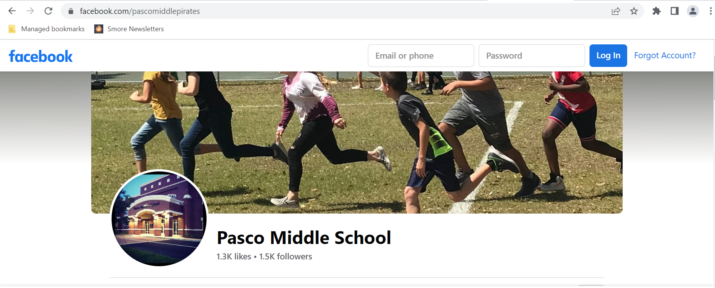
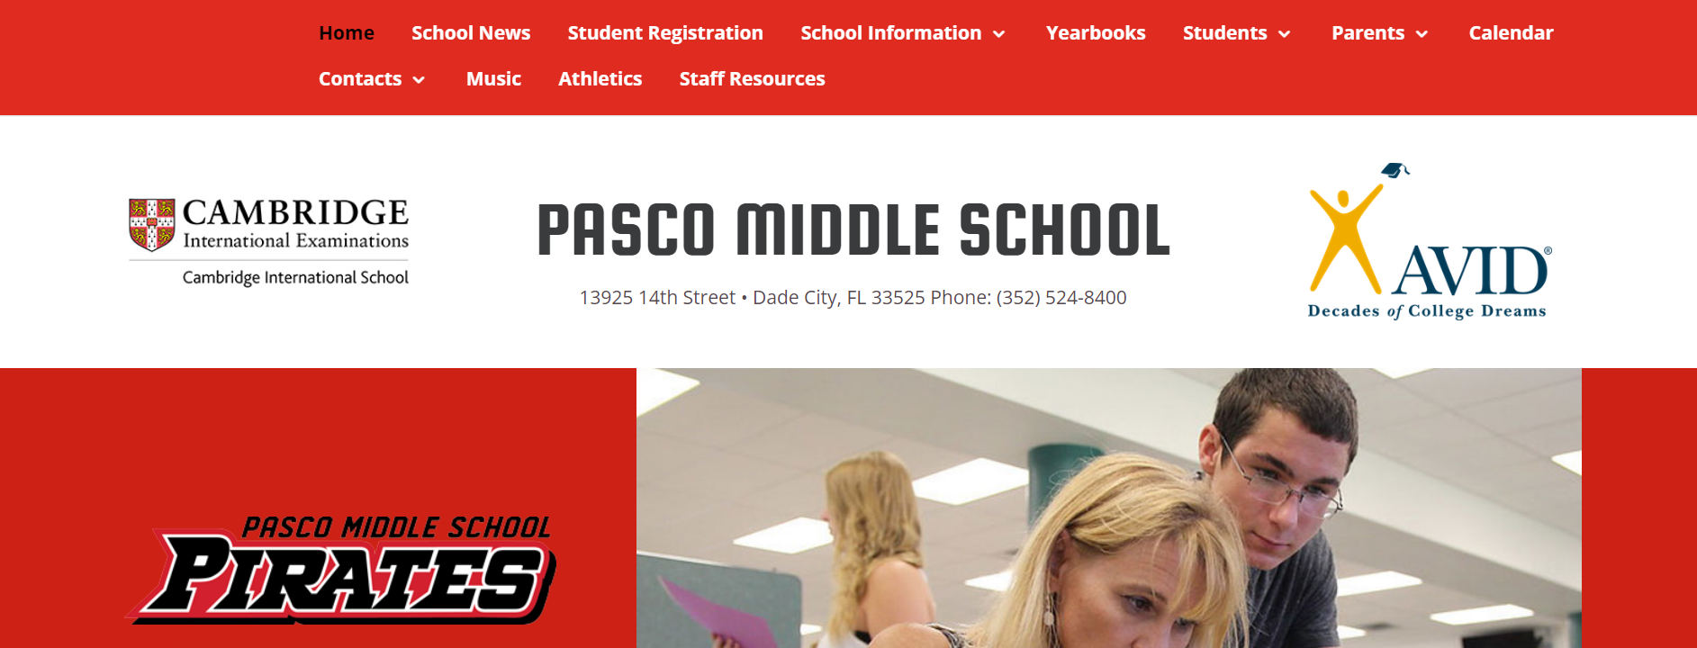
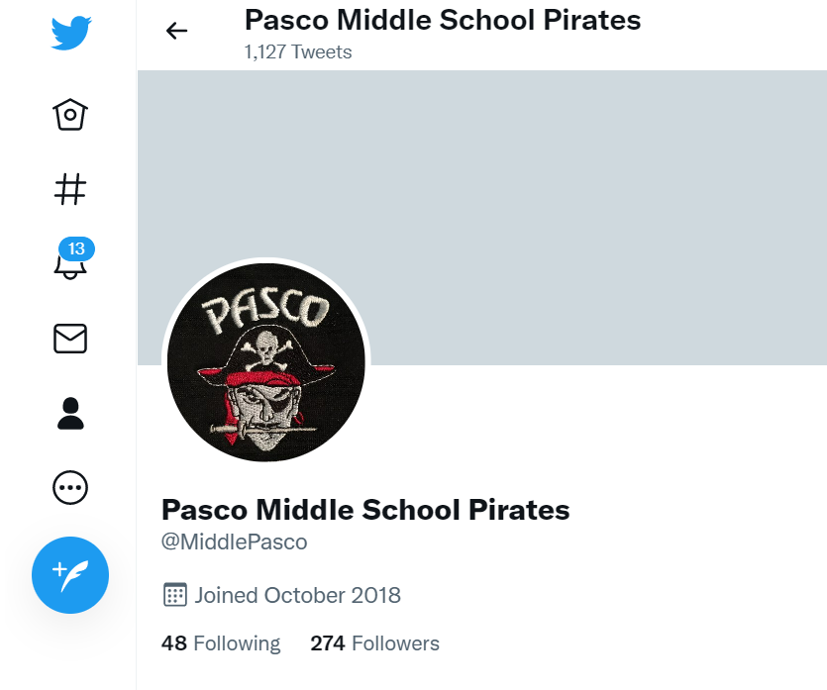
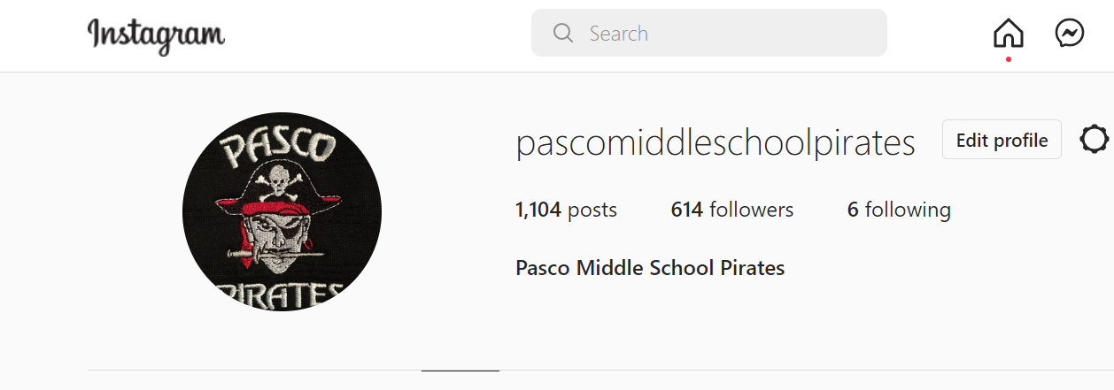
Follow us on Social Media!

Slide 14
Please don’t assume your student will present or communicate all vital information.
Listen to School Connects phone calls, a call and email goes out every Friday.
Our Parent Pirate Press is shared on Friday too via email!
Routinely check the district and school website.
Let the front office staff know if your contact information changes.
Make sure we have your email address and correct phone number in MyStudent
Tip 1 Continued

Slide 15
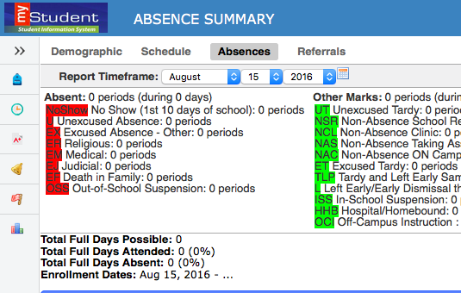
Tip #2 Make MyStudent Your Best Friend!
Check grades, display a customized class report, set up email notifications for student’s average, unexcused absences, or discipline comments.
Set up accounts for BOTH you and your student.
Check school calendar on the website for progress report and report card grades
Contact your student’s teacher, school
counselor or administrator if
you have any questions.
Know your student’s teachers
will be grading their work:
review each syllabi.

Slide 16
Changes to Grading Practices 22-23
Required Learning 70% of Grade
Students must complete all these assignments to pass the course
If a student does not complete an assignment it will show as an “I” in the gradebook until completed.
Final deadlines for these assignments will be determined by the teacher team.
Teacher-Determined 30% of Grade
Students are encouraged to complete these assignments to assist them in mastering the Required Learning Tasks
These are standards aligned and support the required learning tasks
If a student does not complete an assignment in this category they will receive a “M” for missing which has not impact on the students grade.
Conduct, Homework, and Work Habits 0% of Grade
Homework can be used to advance student learning
Homework will have no impact on student learning
Students are encouraged to complete homework as teachers will provide specific feedback on assignments that can lead to future positive outcomes on required learning

Slide 17
Tip #3 Become a Volunteer
https://lolhs.pasco.k12.fl.us/be-a-volunteer-for-the-2019-2020-school-year/
Use this link to complete the volunteer form
Volunteers can chaperone dances, field trips, be guest speakers, etc.

Slide 18
Join Our Parent Pirate Crew! Information Session September 13th
Tip #3

Slide 19
Tip #4 Stay in Touch with Teachers and Staff
Email (please allow 24 hours for response time)
Phone call
Conference
Teacher Contact List
School Website
Teacher MyLearning Page

Slide 20
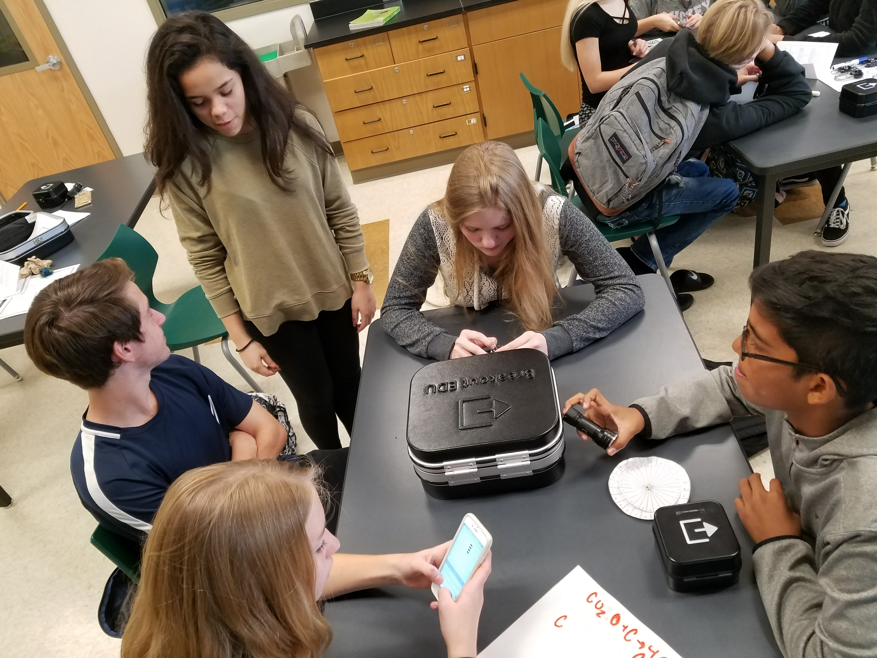
Partner with Teachers to Help Your Children
Parents are the biggest factor of their child’s success.
Regular email contact with teachers
Attending School Events
Meals/Time Together
Attend Conferences and School Events

Slide 21
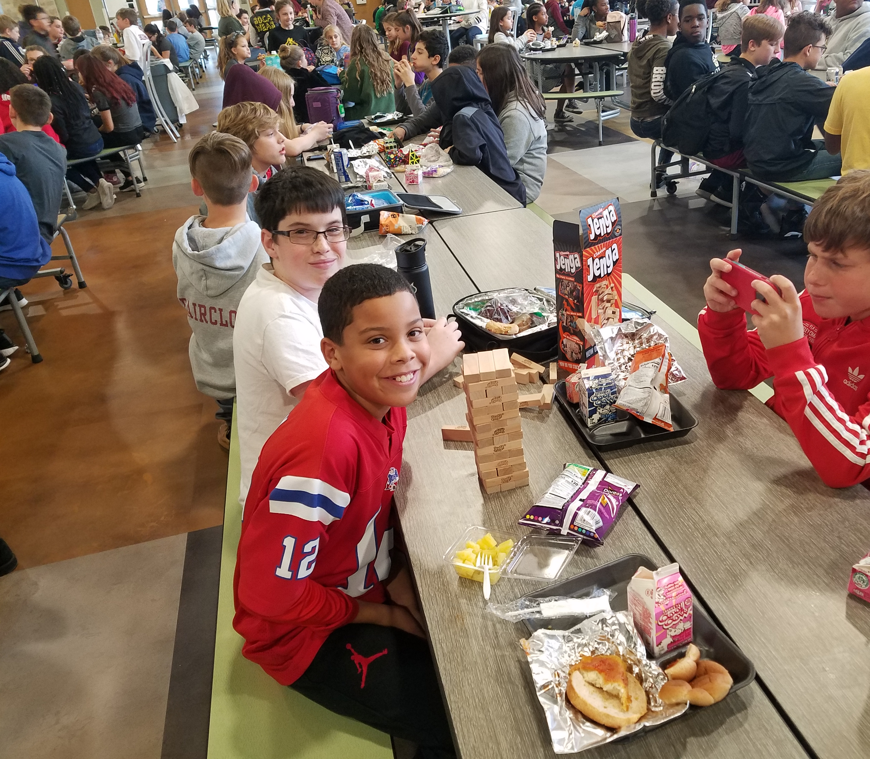
Tip #5 Your Student Needs You NOW More Than Ever!
Grades and attendance are the biggest indicators of overall success in middle school.
Organization & Time Management
Dress Code
Social Emotional Concerns
First friend drama experiences
Resources: School Counselor,
School Nurse, School Social Worker,
School Psychologist, SRO, & Academic Coach

Slide 22
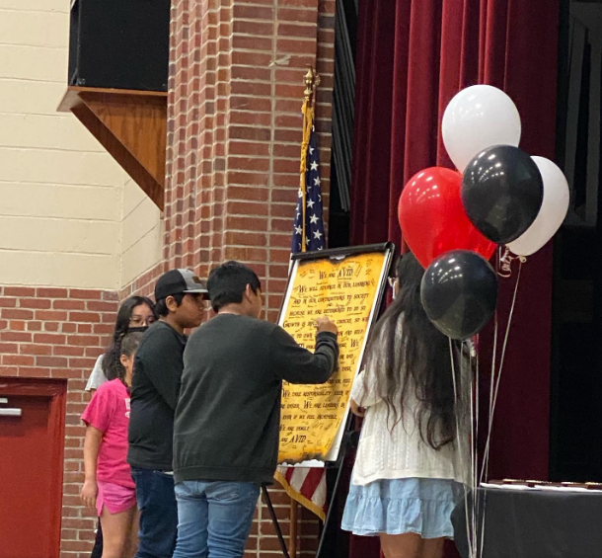
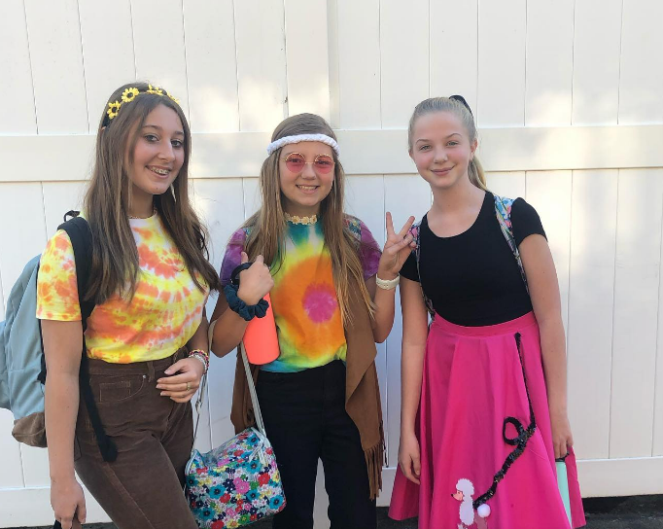
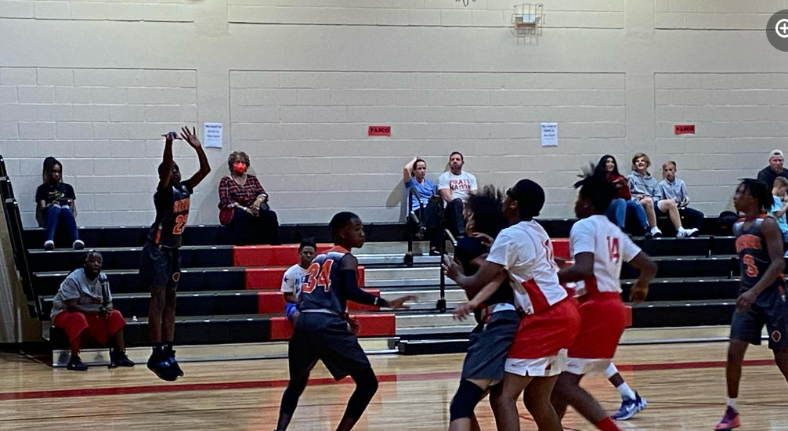
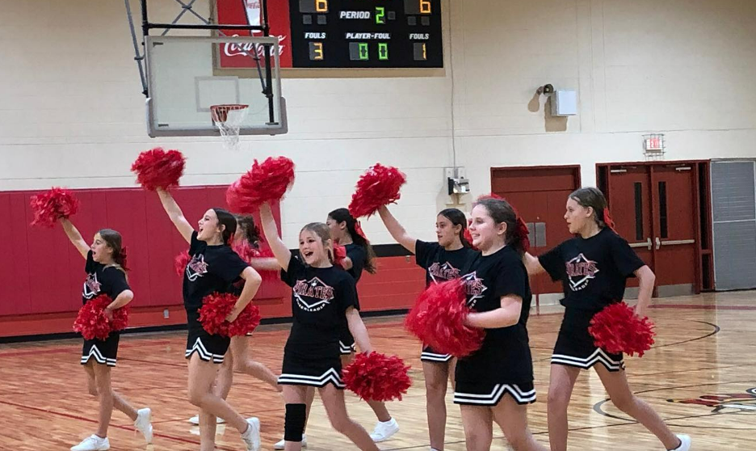
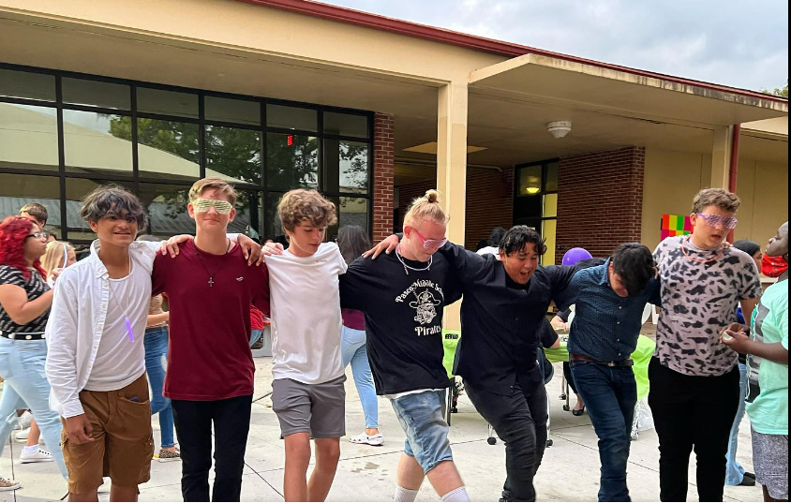
Tip #6 Encourage Your Student to Get Involved!
Clubs
Sports
Special Events at School
National Junior Honor Society
Yearbook
Spanish
Agriculture
Business
Avid
Cambridge
Student Government

Slide 23
Tip #7 Know Your School Support Systems
Intervention Time (Daily)
After School Tutoring
Extended School Day (ESD)
Student Services Staff
TEACHERS!
Parent Pirate Crew

Slide 24
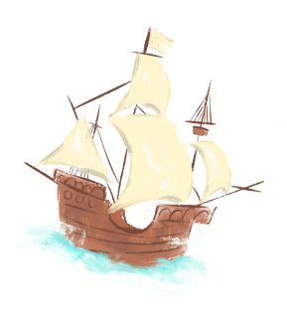
Tip #8 Support Your Student in Practicing These 5 Life Skills
Nutrition- eating breakfast, drinking water, and eating healthy foods
Rest- 8-9 hours of sleep a night help your child recharge, renew, and relax
Fun- read, listen to music, play, create, hangout, and explore.
Exercise- walk, run, dance, pedal, move it for 30 minutes or more a day.
Social Support- Hanging out with people you like and who like you too. Having family and friends you can count on.

Slide 25
Parent Bill of Rights Changes
Please make sure that you complete all elective forms in MyStudent to ensure that your child have access to all the items they need to have access to this school year. It is essential to complete these forms.
If you do not have a MyStudent account, then please set one up, there are directions in English and Spanish on the District School Board of Pasco County Website

Slide 26
Save the Date! Mark Your Calendars!
Meet the Teacher Day!
August 5th, 2022
7:30am-12:00pm

